Slide 1
ICH- GCP
Text
Release Date: DD-Mmm-YYYY

Slide 2
Agenda
ICH-GCP and its purpose
Principles of ICH GCP
Participants in a clinical trial and what are their responsibilities
Audits and inspections
Clinical trial protocol
AE, SAE & ADR
Essential documents required before, during and after the clinical trial

Slide 3

International Conference on Harmonization
ICH is the International Conference on Harmonisation of Technical requirements for Registration of Pharmaceuticals for Human Use.
A unique project that brought together the pharmaceutical industry and regulatory representatives of three regions:
USA
Japan
European Union
Objectives:
Discuss technical and scientific aspects of drug registration
Avoid unnecessary delay in drug development
Safeguard quality, safety and efficacy of drugs

Slide 4
Background of ICH
1) Sulfanilamide Tragedy (1937) – FDA Food, Drug, and Cosmetics Act (1938)
2) Inhuman medical experimentation on Nazi prisoners (WWII) - Nuremberg Code (August 1947)
3) Thalidomide Tragedy (1962) – Kefauver Harris Drug Amendment
4) Declaration of Helsinki (1964)
5) Tuskegee Syphilis Study (1932 – 1972) – Belmont Report

Slide 5
ICH-GCP is Good Clinical Practice guidelines agreed at the conference…..
Definition
"An international standard for the design, conduct, performance, monitoring, auditing, recording, analyses and reporting of clinical trials that provides assurance that the data and reported results are credible and accurate, and that the rights, integrity, and confidentiality of trial subjects are protected“
Exactly what is GCP?
Ethical and scientific quality standards for designing, conducting, recording and reporting trials that involve participation of human subjects
Purpose of ICH GCP
Patient safety
Generation of credible and good quality clinical trial data

Slide 6

Advantages of Harmonisation
Regulatory harmonization offers many direct benefits to both regulatory authorities and the pharmaceutical industry:
protection of public health
preventing duplication of clinical trials in humans
minimizing the use of animal testing without compromising safety and effectiveness
streamlining the regulatory assessment process for new drug applications
reducing the time and resources required for drug development

Slide 7
13 Principles of GCP
Clinical trials should be conducted in accordance with the ethical principles that have their origin in the Declaration of Helsinki, and that are consistent with GCP and the applicable regulatory requirements.
Before a trial is initiated, foreseeable risks and inconveniences should be weighed against the anticipated benefit for the individual trial subject and society. A trial should be initiated and continued only if the anticipated benefits justify the risks.
The rights, safety, and well being of trial subjects are the most important considerations.
The available non-clinical and clinical information on an investigational product should be adequate to support the proposed clinical trial.
Clinical trials should be scientifically sound, and described in a clear, detailed protocol.

Slide 8
Continued…
6. A trial should be conducted in compliance with the protocol that has received prior IRB/ IEC approval/ favorable opinion.
The medical care given to, and medical decisions made on behalf of subjects should always be the responsibility of a qualified physician, or when appropriate a qualified dentist.
Each individual involved in conducting a trial should be qualified by education, training, and experience to perform his/ her tasks.
Freely given informed consent should be obtained from every subject prior to clinical trial participation.

Slide 9
Continued…
All clinical trial information should be recorded, handled, and stored in a way that allows its accurate reporting, interpretation, and verification.
The confidentiality of records that could identify subjects should be protected, respecting the privacy and confidentiality rules in accordance with the applicable regulatory requirement(s).
12. Investigational products should be manufactured, handled, and stored in accordance with applicable good manufacturing practice (GMP). They should be used in accordance with the approved protocol.
13. Systems with procedures that assure the quality of every aspect of the trial should be implemented.

Slide 10


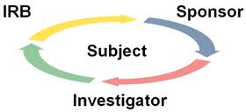

Participants in Clinical Trial
GCP makes various demands of each player and clearly defines the responsibilities of each!

Slide 11

Ethics Committee (EC): Responsibilities
Ethics Committee is an independent body of medical/scientific personnel and non-medical/non-scientific members
Ethical Responsibilities
To ensure the protection of the rights, safety and well - being of human subjects involved in a trial
To ensure unambiguous language in informed consent document
Should pay special attention to trials that may include vulnerable subjects
Scientific Responsibilities
Sound trial design
Statistical validity

Slide 12

Ethics Committee: How to meet responsibilities?
By reviewing and approving/ providing opinion on:
Trial protocol
Suitability of the Investigator
Facilities at sites and in trial
Methods and materials to be used in the trial
Methods for obtaining and documenting informed consent of the trial subjects

Slide 13
Ethics Committee: Composition
ICH GCP
Schedule Y
At least 5 members
At least 1 member whose primary area of interest is a non-scientific area
At least 1 member who is independent of the institution/ trial site
Voting members to be independent of the investigator & sponsor of the trial
Minimum of 7 members (minimum of 5 to form a quorum)
Chairperson not the head of institute/ affiliated to the institute
Mix of medical and non-medical, scientific and non-scientific members
Equal race and gender representation
Include at least one lay person

Slide 14

Sponsor
An individual, company, institution, or an organization that takes responsibility for the initiation, management, and/or financing of a clinical trial
The sponsor may be a pharmaceutical company, a private or academic organization, or an individual
Sponsor can outsource some or all of their responsibilities

Slide 15

Responsibilities of Sponsor/ CRO
Trial design (Protocol & amendments)
Information on IP (IB) & its management
Investigator selection
Notification/submission to RA
Confirmation of review by IRB/IEC
Financing of the clinical trial
Monitoring, trial management, data handling & record keeping
QA/QC, audits and managing non-compliance
Clinical Study Report

Slide 16

Monitoring
“The act of overseeing the progress of a clinical trial, and of ensuring that it is conducted, recorded, and reported in accordance with the protocol, Standard Operating Procedures (SOP), Good Clinical Practice (GCP) and the applicable regulatory requirements.”

Slide 17
Responsibilities of Monitor
Monitor
Verifies if informed consent was taken and the process was documented per requirements
Reviews if all procedures were conducted as per the protocol & regulatory guidelines
Verifies compliance with the IRB/ IEC, regulatory bodies and the Sponsor requirements
Completes a Site Visit Log
Checks if changes made to the CRF were made by authorized site staff and have been signed and dated
Ensures all safety related data has been captured (SAEs, ADRs, IRAEs etc.)

Slide 18
Responsibilities of Monitor
Monitor
Checks that the correct laboratory ranges are applicable to the trial subjects and that they are current
Checks randomization & emergency procedures are appropriate and are documented correctly
Answers any trial related or protocol related questions from site staff
Discusses and documents any issues related to IP handling/ documentation, storage conditions, IP records, reconciliation, expiration date etc.
Inspects storage conditions of laboratory kits, biological samples, expiration dates etc.

Slide 19

Investigator
Principal Investigator (PI):
A person responsible for the conduct of the clinical trial at a trial site. If a trial is conducted by a team of individuals at a trial site, the investigator is the responsible leader of the team and may be called the Principal investigator
Sub-Investigator/ Co-Investigator
Any individual member of the clinical trial team designated and supervised by the PI at a trial site to perform critical trial-related procedures and/or to make important decisions (e.g. associates, residents, research fellows).

Slide 20

Investigator’s Qualification
The investigator should be professionally qualified for the conduct of the trial (current, signed and dated CV)
The investigator should be aware of and comply with GCP and applicable regulations
The investigator should have adequate resources and must maintain a list of qualified individuals to whom trial related activities have been delegated
The investigator should be familiar with the use of the IP
The investigator/institution must permit monitoring/auditing by the Sponsor and inspections by regulatory authorities

Slide 21
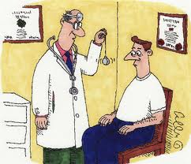
Responsibilities of Principal Investigator
Give medical care to trial subjects/patients
Communicate with the IRB/IEC
Comply with the protocol
Maintain records of IP
Follow randomization procedures and unblinding
Completes proper informed consent process
Submits timely progress report
Ensures Investigational Product and clinical trial supplies
Safety reporting
Documents, records and reports properly including archival
Sees if drug can causes premature termination/suspension of trial

Slide 22
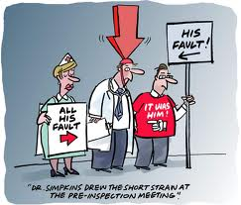
The investigator is responsible for all medical decisions to be taken at the site!!

Slide 23

Knowledge Checks!
Tell 1 responsibility for each:
Investigator
Sponsor
Ethics Committee

Slide 24

Investigational Product (IP): Definition
“A pharmaceutical form of an active ingredient or placebo being tested or used as a reference in a clinical trial, including a product with a marketing authorization when used or assembled (formulated or packaged) in a way different from the approved form, or when used for an unapproved indication, or when used to gain further information about an approved drug.”
The term Investigational Product (IP) includes:
the drug under investigation as well as…..
the comparator (placebo or active drug)

Slide 25

What is an Audit?
Independent examination of trial related activities and documents to determine whether the trial related activities were conducted and the data were recorded, analysed and accurately reported according to the protocol, sponsor SOPs, GCP & the applicable regulatory requirements.
Auditors are independent of the clinical trial.
Audit Types
Routine surveillance
For cause

Slide 26

What is an Inspection?
The act by a regulatory authority(ies) of conducting an official review of documents, facilities, records and any other resources that are deemed by the authority(ies) to be related to the clinical trial and that may be located at the site of the trial, at the sponsor’s and/or contract research organization’s (CRO’s) facilities, or at other establishments deemed appropriate by the regulatory authority(ies).

Slide 27
Clinical Study Protocol
A document that describes the objective(s), design, methodology, statistical considerations, and organization of a trial. The protocol usually also gives the background and rationale for the trial, but these could be provided in other protocol referenced documents.
It should generally include the following topics:
General Information: Along with the protocol title and identifying number, it includes important contacts of Sponsor, its’ medical expert, monitors, investigator, names and addresses of the clinical laboratories and other medical and/or technical department(s) and/or institutions involved in the trial.
Background Information: It includes name and description of the investigational product, with relevant information from the non-clinical studies, reference to literature and data that potentially have clinical significance to the trial. Summary of the known and potential risks and benefits, if any, to human subjects, and a statement that the trial will be conducted in compliance with the protocol, GCP and the applicable regulatory requirement(s).
Trial Objectives and Purpose: A detailed description of the objectives and the purpose of the trial.
Trial Design : The scientific integrity of the trial and the credibility of the data from the trial depend substantially on the trial design. It covers endpoints, randomisation and blinding information with a schematic diagram of trial design. It also includes, expected duration of subject participation, and a description of the sequence and duration of all trial periods , with "stopping rules" or "discontinuation criteria" . Accountability procedures for the investigational product(s), including the placebos and comparators.
Selection and Withdrawal of subjects: Subject inclusion and exclusion criteria , subject withdrawal criteria, with the details of when and how subjects to be withdrawn , type and timing of the data to be collected for withdrawn subjects. Whether and how subjects are to be replaced. The follow-up for subjects withdrawn from investigational product treatment/trial treatment.

Slide 28
Protocol Continued….
Treatment of Subjects: A detailed information regarding treatment plan including the route/modes of administration, and the treatment period, including the follow-up period for subjects for each investigational product treatment/trial treatment group/arm of the trial. Medication treatment permitted and not permitted before or during clinical trial. Procedures for monitoring subject compliance.
Assessment of Efficacy : Specification of the efficacy parameters and methods and timing for assessing, recording, and analyzing of efficacy parameters.
Assessment of Safety :Specification of safety parameters. The methods and timing for assessing, recording, and analyzing safety parameters. Procedures for eliciting reports of and for recording and reporting adverse event and inter-current illnesses. The type and duration of the follow-up of subjects after adverse events.
Statistics: A description of the statistical methods to be employed, including timing of any planned interim analysis. Reason for choice of sample size, including calculations of the power of the trial and clinical justification. Level of significance to be used , criteria for the termination of the trial. Procedure for accounting for missing, unused, and spurious data along with reporting procedure for any deviations from the original statistical plan , as any deviation from the original statistical plan should be described and justified in protocol , or in any other concerned document.
Direct Access to Source Data/Documents : The sponsor should ensure that it is specified in the protocol or other written agreement that the investigator or institution will permit trial-related monitoring, audits, IRB/IEC review, and regulatory inspection, providing direct access to source data/documents.
Quality Control and Quality Assurance: Elaborates the quality control and assurance plan s for all the protocol related procedures.
Ethics : Description of ethical considerations relating to the trial.
Data Handling and Record Keeping: Instructions for handling all the trial related data and record keeping procedures.
Financing and Insurance: Financing and insurance related details are documented, if not addressed in a separate agreement.
Publication Policy: Publication policy, if not addressed in a separate agreement, is detailed mainly describing the authority and discretion of publishing the trial generated information, through various publication channels.
Supplements : As required for a particular protocol ,depending on the study requirement as detailed in Structure and Content of Clinical Study Reports.

Slide 29
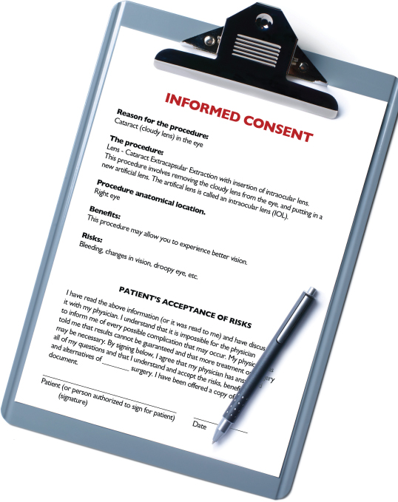
Informed Consent
A process by which a subject voluntarily confirms his/her willingness to participate in a particular trial, after having been informed of all aspects of the trial that are relevant to the subject’s decision to participate.
Informed consent is documented by means of a written, signed and dated informed consent form.

Slide 30

Elements of Informed Consent
Subject’s responsibilities
Aspects which are experimental
Reasonably foreseeable risks/inconveniences
Reasonably expected benefits
Alternative procedure(s)/treatment(s)
Compensation for trial related injury
Anticipated payments
Anticipated expenses

Slide 31
Elements of Informed Consent (cont.….)
Voluntary participation/free to withdraw
Direct access to medical records and by whom
Confidentiality
Make available information that may affect the subject’s willingness to continue
Contact number(s)
Foreseeable circumstances under which participation may be terminated
Duration of participation
Approximate number of subjects involved

Slide 32
ICF: Signature Page
This page contains a place each for the subject, legally acceptable representative, impartial witness, and the person taking informed consent.
For each, the following has/ may have to be completed:
the signature/ thumb impression of non-dominant hand
the date and time
the name
for LAR, the relationship with the patient

Slide 33

Informed Consent Translation
Translations in locally used language provided
Back-translations in English always provided
Translations and back translations submitted to the IRB/ IEC for review and approval of the translations
Translations may be sent to sites for review of the correctness of the translated document

Slide 34
Special ICF Procedures
Witnessed consent by:-
Impartial witness, e.g., if subject is unable to read
Emergency situations, e.g., unconscious subjects
Legally acceptable representative, e.g., pediatric trials, mentally ill subjects
All methods must be approved by IRB/IEC

Slide 35
Patient
Literate
Illiterate
Medically incompetent
LAR
Non-dominant thumb impression
Illiterate
On recovery take Consent
Non-dominant thumb impression
Sign & Date the ICF
Literate Impartial Witness
ICF must be signed & dated by the Investigator

Slide 36
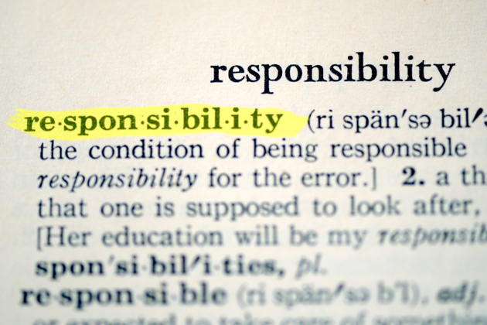
ICF: Investigator’s responsibilities
Consent the subject prior to participation in a trial and before ANY trial procedure, including blood tests for screening unless it’s part of normal clinical practice
Ensure the subject is fully informed
Give ample time and opportunity to the subject to ask questions
Do not unduly influence a subject to participate
Document the consent procedure
Give the subject a copy of the signed and dated ICF
Obtain written approval from IRB/IEC on ICF and all changes to ICF
Ensure the language is understandable to the subjects

Slide 37
Knowledge Checks!
What is the difference between Audit and Inspection?

Slide 38

What are Source Documents?
Documents (paper or electronic) that support what was recorded in the trial as the actual research data or measurement.
Are a source to validate ALL trial data.
Source documents must be available to anyone
reviewing the trial (e.g., monitor, auditor).
“Where you wrote it down first”.

Slide 39
Source Documents include...
Hospital records, clinical and office charts, lab. notes, memoranda, subject diaries or evaluation checklists, pharmacy dispensing records, recorded data from automated instruments, copies or transcriptions certified after verification as being accurate copies, microfiches, photographic negatives, microfilm or magnetic media, X- rays, subject files and records kept at the pharmacy, at the labs and medico-technical departments.

Slide 40

Why is Source Data Verified?
To ensure the quality and integrity of the trial data for the clinical trial
To confirm that the patient exists and was eligible for the trial
To ensure that the informed consent process was adequately conducted and documented
To ensure there is adequate evidence of trial participation and exposure to investigational treatment
To have documentation confirming the diagnosis of the disease/ medical condition

Slide 41
Case Report Forms (CRFs)
These documents are used to record the information derived from trial activities that will be used as data
Standardized format provided by the Sponsor
May be paper based or electronic
CRFs are NOT source documents unless stated as such in the trial protocol
CRFs require a supporting source document to assure the validity of the data recorded
CRFs must accurately match the source documentation.
Any errors in entry should be queried, and must be corrected promptly with sign and date

Slide 42
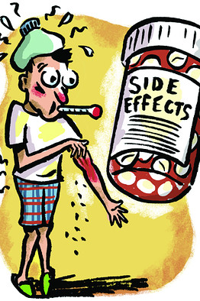
Adverse event (AE)
Any untoward medical occurrence in a patient or clinical investigation subject administered a pharmaceutical product which does not necessarily have a causal relationship with this treatment.
An AE can therefore also be :
Any unfavorable and unintended sign (including abnormal laboratory findings)
Symptom or disease temporally associated with the use of a medicinal (investigational) product
Worsening of a pre-existing condition

Slide 43
Adverse Drug Reaction (ADR)
All noxious and unintended responses to a medicinal product related to any dose should be considered as an ADR.
Suggests a relationship to trial medication.
All AEs must be recorded irrespective of relationship to the study drug.
All ADRs are AEs, but all AEs are not ADRs.

Slide 44
Serious Adverse Event (SAE)
Results in Death
S
A
E
Is Life threatening
Inpatient or Prolongation of Hospitalisation
Persistent or Significant disability/Incapacity
Congenital Anomaly/ Birth Defect
Medically Significant

Slide 45
Definitions - Relationships
AEs
ADRs
SAEs
UADRs

Slide 46
Reporting SAEs
Reporting procedure will be fully explained in the protocol
SAEs are reported IMMEDIATELY (within 24 hours) by the investigator to the sponsor/monitor, followed by written report
SAEs are reported to the site’s IRB/ IEC within 7 days of the occurrence of the event
SAEs are reported within 7 or 15 days to regulatory authorities as per the seriousness

Slide 47
Pregnancy and Trial Subjects
Most trials require that subjects are using ‘adequate contraception methods’ as part of the entry criteria
Most sponsor companies will request that all pregnancies are reported in the same way as serious adverse events i.e. immediately and using the SAE report form
Pregnancies are ‘followed’ to learn the outcome as ‘congenital anomaly/birth defect’ is a category of SAE

Slide 48
Knowledge Checks!
What is a SUSAR?

Slide 49

Essential Documents
DURING CONDUCT OF TRIAL:
Investigator’s Brochure updates
Revisions to protocol, ICF, any other written information provided to subjects, advertisements for subject recruitment
Dated, documented approval from IRB/ IEC for any such revisions
Regulatory authorities notification/ approval for any such revisions
CV of new investigators, sub investigators
Updates to lab normal ranges
Documentation of IP and trial material shipment
Relevant communications other than site visits

Slide 50
Essential Documents (cont.…)
DURING CONDUCT OF TRIAL:
Signed informed consent forms
Source documents
Signed, dated and completed CRFs
Notification of SAEs and related reports
Notification regarding serious, unexpected adverse drug reactions
Interim or annual reports to IRB/ IEC and authorities
Subject screening, identification, enrollment logs
IP accountability at the site
Signature sheet
Records of retained body fluids and tissue samples, if any

Slide 51

AFTER COMPLETION/ TERMINATION OF TRIAL:
Investigational product accountability at site
Documentation of investigational product destruction
Source documents
Completed subject identification code list
Final report by investigator to IRB/ IEC
Clinical trial report

Slide 52
Which documents are submitted?
Regulatory approval
Available safety information, IB/ package insert and updates, report of prior investigations
Protocol / Amendments
Patient Information Sheet / Informed Consent Form and updates/ Translations/ Back translations
Subject recruitment procedures (ads), patient instructions
Insurance, Indemnity, Contract, compensation & payments to the patient
Investigators’ CV and Investigator’s Undertaking
Other project-specific documentation, e.g., diaries
Any additional IRB/EC specific requirements (e.g. Questionnaire, CRF)
Patient recruitment procedures/ advertisements, if any

Slide 53

What is archived: Essential Documents
ICH requires that all essential documents should be retained until at least two years after the last approval of a marketing application in an ICH region and until there are no pending or contemplated marketing applications in an ICH region, or at least two years after the formal discontinuation of the clinical development of the Investigational Product

Slide 54
Reference
Text

Slide 55

Thank You!
For any feedback/comment/clarification please contact us at PALS@tcs.com
Copyright © 2012 Tata Consultancy Services Limited
V 00.00

Slide 56
Change/Revision History
Revision No. | Revision Date | Revision Description | Slide No. | Rationale for the change | Change type (Add / Modify / Delete)
00.00 | NA | Initial Release

Slide 57
DOCUMENT RELEASE NOTICE
This XXXX, Version aa.bb, is released for use in Tata Consultancy Services (TCS) with effect from DDMMYY
This Training Material is subject to TCS Document Control Procedure. TCS reserves the right to make additions, modifications or alterations to the existing content or release a newer version of this document.
Softcopy of the latest version of the document is available in the ABCDEFG
Comments suggestions or queries should be addressed to PALS@tcs.com.
Prepared by:
Text
Role
Date:
Text
Reviewed by:
Text
Role
Date:
Text
Approved by:
Text
Role
Date:
Text
Authorized by:
Text
Role
Date:
Text
Effective Date: DD-Mmm-YYYY

